Slide 1
Livestock Intensification in Indonesia
Emma Krampe, Harsh, Nabil Rafka
Notes:
-Start from different livestock systems, how it will change from a global level in intensification for literature review (present and future conditions)
-then consider indonesia
-Refer to current system and if there are natural resources to provide for cattle production in the future (2050)
-Consider livestock intensification policies - find policies saying they want to shift from pasture to large scale agriculture
-Start from worldwide situation for introduction
-Is agriculture rainfed or irrigated in Indonesia?
Global level: pasture vs. intense systems in a qualitative way if no data, how is meat consumption changing on a global level

Slide 2
Aim of the Study: Research Question
We will perform a quantitative analysis of the water footprint of four scenarios for Indonesian livestock production and a qualitative analysis of other issues specific to Indonesian livestock intensification including livestock policies, environmental management, and economic feasibility. The results will provide evidence for our recommendations to improve Indonesian livestock intensification from a water scarcity perspective.

Slide 3
Study Area: Indonesia
Made up of 17,508 islands, the largest being Sumatra including the largest beef-producing area Java (1)
Pop. 267.7 million, growth rate of 1.1% (1)
Indonesia is generally viewed as a water scarce country with water stress coming mainly from irrigation and growing domestic use as population increases (1)
16.6 million heads of cattle, 90% held in smallholder farming systems (1)
Domestic production satisfies 45% of beef demand, the rest is imported mainly from Australia
Commercial farming (10% of farming operations) is mostly concentrated in Java (1)

Slide 4
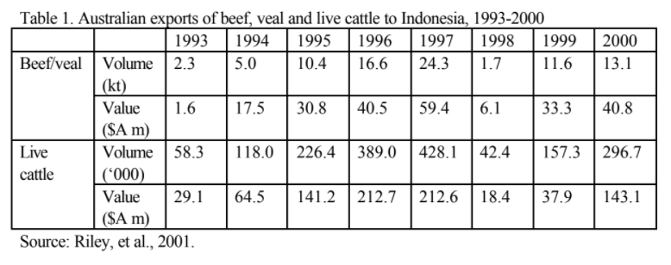
Import/Export
Most of Indonesia's beef and live cattle imports originate in Australia (see Table 1), and Indonesia remains as the largest export destination for Australian live cattle with around 296,700 head exported in 2000 (Riley et al., 2001).

Slide 5
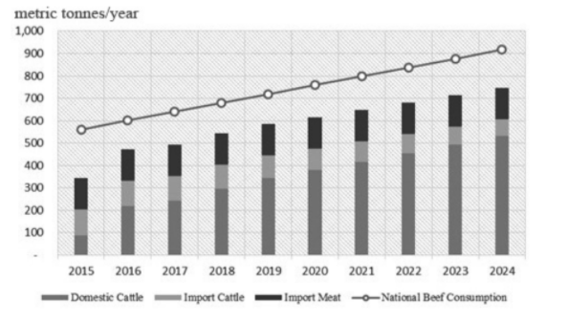
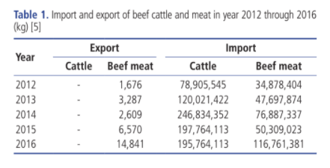
Study Area: Indonesia (Cont.)

Slide 6
Indonesia Meat Industry
the vast majority of cattle operations in East Java are small scale, family-run, cow-calf enterprises, relying as far as possible on locally available feeds.
a large proportion of East Java’s and Indonesia’s cattle production will continue to depend on millions of intensive, small scale, backyard cattle breeders and the feed supplies produced as a by-product of the intensive, small-scale cropping systems in which they are embedded.
One of the problems which cause the beef cattle industry to grow slowly in Indonesia is the absence of government regulation to protect farmers from middleman-traders.
Rambon cattle as a secondary option to support crop production (2)
The gap between beef supply and demand is increasing. Live cattle and frozen meat imports are a shortcut solution in the short-medium term (1)

Slide 7
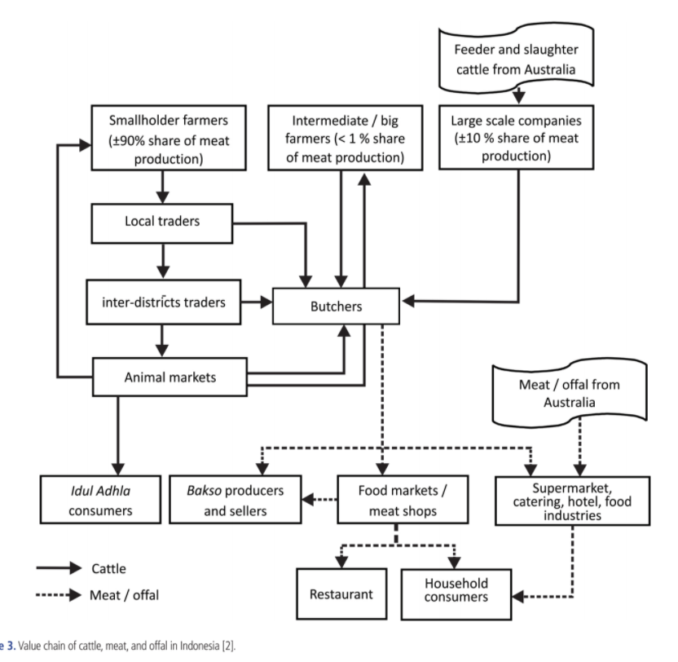
Indonesia Cattle Value Chain

Slide 8
Water Scarcity in Indonesia
Indonesia is under increasing water stress due to climate change and increasing irrigation withdrawal
Although Indonesia is projected to increase the amount of rainy days due to changing climate, high-intensity rain events will increase potentially creating stress on agricultural demand (3)
Flooding is a regular occurence with an average of 168,000 hectares of crop inundated by floods each year from 2003-2013 (3)
Water management efforts by the government are hindered by decentralization, weak coordination and policy inconsistencies across government agencies (3)

Slide 9
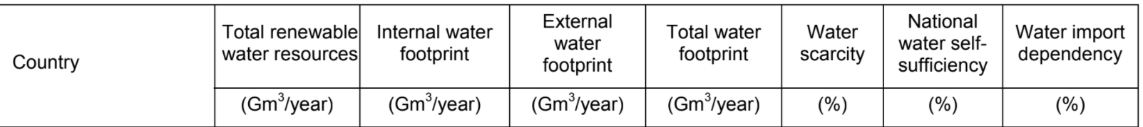
Water Scarcity (Cont.)
The table shows the water inputs and outputs for Indonesia (7)

Slide 10
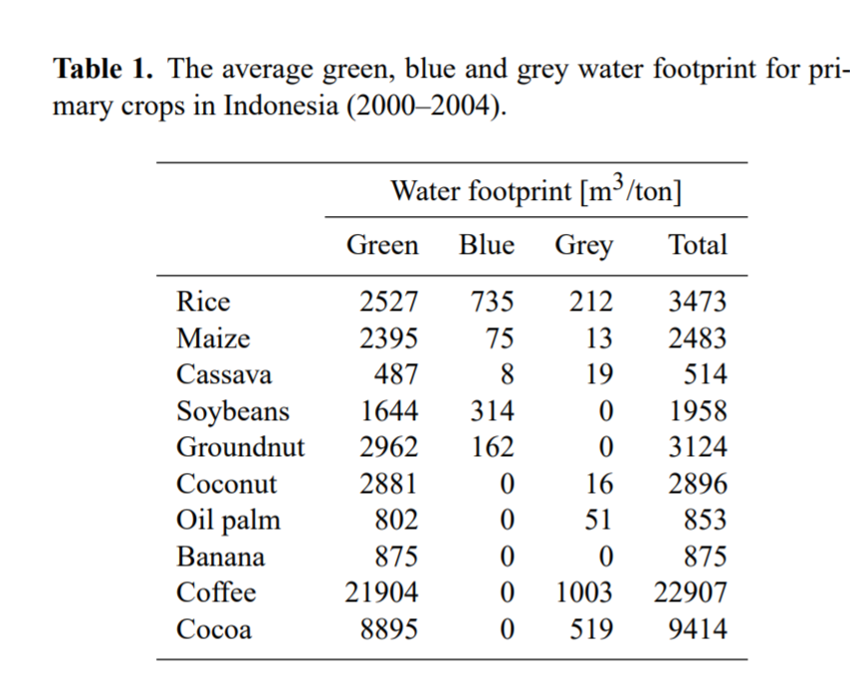
Water Scarcity (cont.)
The table to the right shows crops and their corresponding water footprints per ton of crop
These values may be used to calculate the feedstock water footprints for the cattle
Indonesia is facing increasing water scarcity primarily due to expansion of oil palm production which causes increased precipitation runoff and redistribution of local water resources

Slide 11
Integrated Water Resources Management 2015-2019 Plan
Government’s goal for improving water resource management (3):
(i) Improved land use planning and management
(ii) 1.0 million ha of new irrigation systems
(iii) increased water storage, 49 new dams
(iv) reduce flooded area by 200,000 ha
(v) improved water quality

Slide 12
Livestock Intensification Methods Evaluated
Water footprints will be calculated under the following scenarios:
Smallholder farming w/ locally grown feedstock (corn)
Smallholder farming w/ locally grown feedstock (native grasses)
Import Australian cattle and raise until slaughter
Import beef directly

Slide 13
Factors for integrating crop and cattle production
Facing the problem of a shortage of land on Java Island, and to meet the demand for meat production, various approaches to cattle production systems are required. Opportunities include:
i) Crop-livestock integrated system: This system is appropriate for Java Island due to the limited availability of land. An FAO report concluded there were benefits of restricted use of resource lands to mixed crop and livestock enterprises [31].
ii) Plantation–livestock integrated system: Integrated palm oil plantation and cattle systems have been the most practical systems in Indonesia and Malaysia over the past two decades.
(a) Availability of Crop Residues
(b) Utilisation of Rice Straw
(c) Planted Forages
(d) The Feed Supply Chain

Slide 14
Conclusion
Characterization of the study area and Indonesian beef industry
Quantitative Analysis:
Evaluate water footprint of 4 scenarios of livestock production
Qualitative Analysis:
Government policies
Water management goals
Economic Feasibility
Discussion of recommendations and other solutions for livestock intensification

Slide 15
References
Agus, A., & Mastuti Widi, T. S. (2018). Current situation and future prospects for beef cattle production in Indonesia — A review. Asian-Australasian Journal of Animal Sciences, 31(7), 976–983. https://doi.org/10.5713/ajas.18.0233
Nugroho E, Azizah S, Susilawati T and Novianti I 2013: Socio-economic potential of Indonesian native cattle in supporting meat self-sufficiency in Indonesia. Livestock Research for Rural Development. Volume 25, Article #202. Retrieved December 23, 2020, from http://www.lrrd.org/lrrd25/11/nugr25202.htm
Quincieu, Eric. (2015). Summary of Indonesia’s Agriculture, Natural Resources, and Environmental Sector Assessment. ADB Papers of Indonesia. https://www.adb.org/sites/default/files/publication/177036/ino-paper-08-2015.pdf
Priyanti, A., Hanifah, V.W., Mahendri, I.G.A.P., Cahyadi, F. & Cramb, R.A. (2012), “Small-Scale Beef Cattle Production in East Java, Indonesia”.
Hutasuhut, M., H. Chang, G. Griffith, C. O’Donnell, and H. Doran. 2001. “The Demand for Beef in Indonesia: Implications for Australian Agribusiness.” Working Paper Series in Agricultural and Resource Economics. Armidale, AU: University of New England.
Chapagain, A.K. & Hoekstra, A.Y. (2004). Water footprints of Nations: Volume1: Main Report. UNESCO-IHE.

Slide 16
Extra Slides

Slide 17
Methods of Livestock Intensification
-Cultivation of leucaena legumes feedstock instead of native grasses - improves beef production for smallholder farming systems (2-20 cattle) (EMMA cite)
-In Java, cattle are imported from Australia and raised to maturity in feedlots (EMMA cite)
-Close integration of crop and livestock production permits the growth of beef cattle numbers
-Control of female breeding cattle which are slaughtered at excessive levels, breeding and reproductive technologies, feeding strategies, simple technology development, farmer empowerment, technology transfer, intensive feedlot systems, and integration of cattle farming system with palm oil plantations or other productive plants enterprises are among the issues that should be addressed as a priority to develop and improve domestic beef production in Indonesia. (Current situation and future prospects for beef cattle production in Indonesia — A review) in conclusion

Slide 18
Methods of Livestock Intensification- continued
-Bali cattle are the predominant beef cattle in the Eastern Islands of Indonesia- The declining population should be improved by applying strategies to reduce calf mortalities, decrease the slaughter of productive cows, and prepare and retain appropriate bulls in the herds - No significant improvement in production and reproduction traits is likely in a randomly mated population such as exists at the moment- The activities of breeding institutes and projects need to be reviewed to re-evaluate their location and operations for producing better Bali cattle in the future.- AI should use semen from proven bulls not only to produce commercial stock but to contribute to genetic improvement programs.( STRATEGIES TO IMPROVE BALI CATTLE IN EASTERN INDONESIA) talib et al in recommendations / conclusion

Slide 19
SAFA sustainability Performance of the analysed farms (FAO)
(Journal of Sustainable Development)
SAFA framework can be beneficial to government institutions and existing sector sustainability concerns and concerns about the farmer’s needs, especially smallholder farmers with little resources to improve their sustainability performance.
Can be used as an already in use solution?

Slide 20
Reason of no intensification
The main drivers that explain a lower sustainability performance between the analysed systems seem to be related with limitations in access to information and knowledge, networks and economic resources

Slide 21
ACIAR project
A research project was initiated in East Java in 2010 to explore ways of increasing calf production and cattle growth rates utilising locally available feeds (ACIAR Project LPS/2008/038). As part of this project, a survey was conducted from March to May, 2010, in four villages in East Java – three adjoining lowland villages (Klampok in Probolinggo District and Dandanggendis and Sumberanyar in Pasuruan District), referred to here as the lowland site, and one upland village (Srigonco in Malang District), referred to here as the upland site (Fig. 1). Probolinggo and Pasuruan encompass fertile irrigated plains about 25-150 masl, while Malang is a rainfed agricultural area about 550 masl with a seasonally dry climate.
Respondents in the 2010 survey were 194 cattle producers owning Ongole cows – 78 in the lowland site and 116 in the upland site. Respondents were interviewed using a structured questionnaire that included questions about household composition, land ownership and use, crop production, and livestock production, including specific questions on sources of feed and the sale of stock. In addition, a brief questionnaire survey was undertaken of 30 cattle traders from both sites and of 40 feed traders, mainly in the lowland site. Monthly recording of feed availability from farmers’ land was also conducted throughout 2011.

